Slide 1
Network Planning with Deep Reinforcement Learning
Hang Zhu
Varun Gupta, Satyajeet Singh Ahuja, Yuandong Tian, Ying Zhang, Xin Jin

Slide 2
Network planning problem
Critical step in dimensioning the backbone network to satisfy operational requirements
Cross-layer
Multi-phased
Failure-aware
IP layer
Short-term
Reliability
Optical layer
Long-term
Multiple failures
Notes:
Large content service providers usually operate a global network. The backbone network serves hundreds of terabits traffic at any given time.
To meet the operational requirements (such as providing sufficient bandwidth for given traffic demand, robust to failures), it’s a critical step in dimensioning the backbone network, which is known as the network planning problem.
The network planning problem is extremely hard in practice.
First, it’s cross-layer as it considers both the IP layer and the optical layer.
We need to make decisions in both layers to form a network plan
Second, it’s a multi-phased, iterative process.
In production networks, the planning process is done over the short-term and long-term horizons respectively
to generate short-term actionable signals for operational teams, while allowing optimal long-term network evolution strategy
Third, it’s failure-aware. We need to ensure the reliability of the backbone network under different failure scenarios.

Slide 3
Network planning problem
A->D: 100Gbps, under several single-fiber failures
Notes:
Here we show an example to illustrate the failure-aware multi-phase planning.
There are 6 sites
And we want to support 100Gbps from A to D under the single-fiber failures (BC and AE).
Short-term planning is to decide the capacity of the two existing IP links, shown as dotted lines .
One feasible network planning is to provision 100Gbps for IP link1 (ABCD) and IP link2 (AEFD). So that under any of single-fiber failures, it can still provide sufficient bandwidth from A to D.

Slide 4
Network planning problem
A->D: 100Gbps, under several single-fiber failures
Notes:
In a long-term planning, we can change both the optical and IP topology.
Assume that we decide to add a new fiber B-F, which also introduces another new possible failure.
There are two options to add a new IP link between A and D, link 3 (A-B-F-D) and link 4 (A-E-F-B-C-D).
A plan with a lower cost is to provision bandwidths on IP link1 and link3, since they share one fiber A-B, and only consumes 5 fibers.

Slide 5
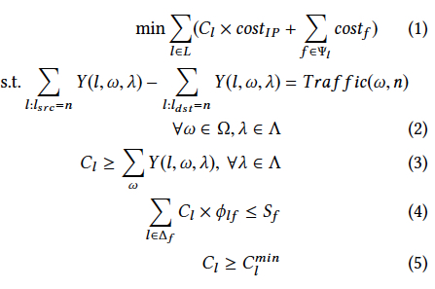
Existing approach
ILP problem
Objective
Flow conservation constraints
Link capacity constraints
Spectrum efficiency constraints
Existing topology constraints
Notes:
Existing approach formulates the network planning problem as an Integer Linear Programming (ILP) problem.
The objective of the ILP is to minimize the total network cost, which is a sum of the cost on IP layer and optical layer
Equation 2 is the Flow conservation constraint. It represents the amount of egress traffic needs to be equal to
the amount of ingress traffic plus the node’s self-generated traffic for every flow under every failure scenario.
Equation 3 is the Link capacity constraint
which means the capacity of each IP link should be no smaller than the aggregated traffic volume on the link under any failure.
Equation 4 is the spectrum consumption constraint on each fiber.
The spectrum consumed over a fiber is the sum of IP link capacities going over the fiber multiplied by the corresponding spectrum efficiency.
And equation 5 is the existing topology constraints, which are used to avoid churns of the topology from an operational perspective.

Slide 6
Existing approach
ILP problem
ILP solvers
Scalability issues
Human-designed heuristics to
trade optimality for tractability
Topology decomposition
Topology transformation
Failure selection
Notes:
Such an ILP problem will be fed into some ILP solvers, such as Gurobi, CPLEX.
However, the ILP approach usually hits the limit of scalability in production-scale problems.
In such cases, people rely on heuristics to trade optimality for tractability. We list some of them here.
First, Topology decomposition means the topology is decomposed into several smaller sub-topologies
and each sub-topology is solved with ILP separately.
Topology transformation aims to reduce the search space or the number of variables,
such as enlarging the capacity unit that can be added over some or all the links, or restricting capacity additions on fibers or IP links,
or collapsing multiple nodes and links together.
Failure selection means instead of satisfying all failure scenarios jointly, we only select a subset of the failure scenarios for the ILP.
Based on the solution, we add more failure scenarios to the ILP until all scenarios are added.
Different heuristics share the same idea—they all aim to prune the search space to make the problem tractable.
And it’s a tedious, time-consuming iterative process even for experts to find a good trade-off
between the optimality of the solution and the tractability of the ILP problem.

Slide 7
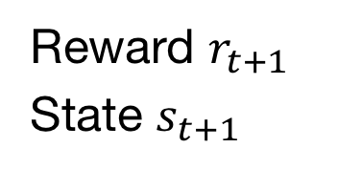
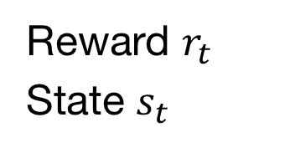
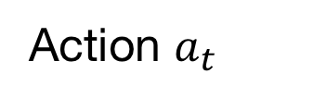
Why a deep RL-based approach?
Action $a_{t}$
RL agent
Environment
Reward $r_{t}$
State $s_{t}$
Reward $r_{t+1}$
State $s_{t+1}$
--------
Notes:
Our approach is revisiting this problem with a different take using deep reinforcement learning.
Someone may ask why RL can help solve the network planning problem.
As we know, a typical goal of RL is to train the RL agent to learn to take multiple actions in an environment
to maximize the accumulated reward it receives.
The environment provides the state as the input and reward as the feedback.
An alternative is to apply supervised learning which uses a training set with labeled samples to train a neural network.
However, supervised learning usually requires a large training set and a label for each sample in the training set.
And the label, which is the optimal plan for a network, is hard to obtain for our problem, especially for large-scale network topologies.

Slide 8
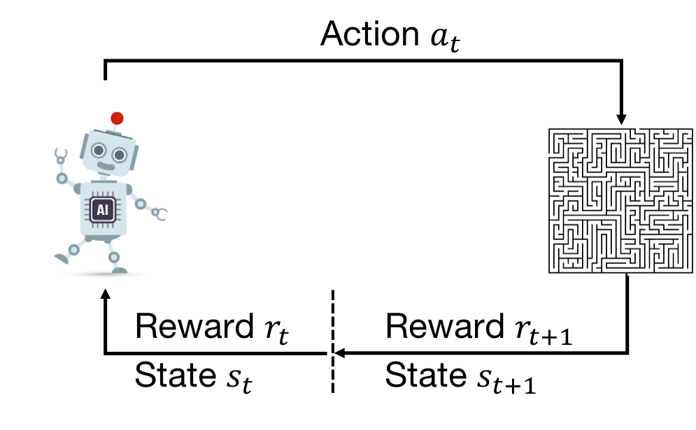
Why a deep RL-based approach?
RL is designed to solve multi-decision making problems
RL agent
Environment
RL automatically derives human-designed heuristics
Notes:
There are basically two characteristics that make network planning a good fit for RL.
First, network planning needs to make multiple decisions on the IP and optical layers,
and multi-step decision making is exactly the kind of problems that RL is designed to solve.
Second, the RL agent explores the search space and exploits the learned structure of the environment to optimize its policy.
This is similar to how humans design heuristics to take advantage of the network planning problem structure to solve the problem.
The real appeal here is that the RL agent can automatically do this and relieves humans from the tremendous efforts of developing the heuristics.

Slide 9
NeuroPlan: a deep RL-based approach
Notes:
So we build our approach Neuroplan with deep RL. The input of Neuroplan consists of five component:
Traffic demand, network topology, failure scenarios, reliability policy and cost model

Slide 10
NeuroPlan: a deep RL-based approach
Notes:
The RL agent only needs to encode the network topologies.
The other four (traffic demand, failure scenarios, reliability policy and cost model) are handled by the plan evaluator.
The RL agent interacts with the plan evaluator to learn to generate network plans that minimize the network cost while satisfying the traffic demand under the reliability policy.
The plan evaluator generates rewards to the RL agent.
It receives the network plan from the RL agent, checks whether the traffic demand is satisfied under different failure scenarios,
and uses the cost model to compute a cost of the plan.

Slide 11
NeuroPlan: a deep RL-based approach
Notes:
After the learning process is completed, the RL agent outputs an initial plan for the first stage.

Slide 12
NeuroPlan: a deep RL-based approach
Notes:
At the second stage, the ILP solver finds the final plan in the pruned search space near the initial plan.
We will discuss such hybrid approach later

Slide 13
Adapting RL for network planning
Challenge 1: How to trade off between optimality and tractability
Challenge 2: How to design RL training process
Challenge 3: How to encode network topology
Notes:
There are mainly three challenges to adapt RL for network planning

Slide 14


Challenge 1: How to trade off between optimality and tractability
Solution: two-stage hybrid approach
search space
optimal
$$α_{1}$$
RL
$$α_{2}$$
Notes:
We can use the RL to find reasonably good solutions. But given the combinatorial nature of the problem,
it is both unpredictable and time-consuming for the RL to find the optimal solution directly.
So we use a two-stage hybrid approach which uses RL to prune the search space and bootstrap ILP.
In the second stage, we use ILP to only search the space near the solution found by deep RL.
We use the relax factor alpha to control the size of the space to explore by ILP.
The relax factor alpha provides a tunable knob for the network operator to trade-off between optimality and tractability.
A small alpha may not include the optimal solution in the search space, but the ILP solver may finish the second stage quickly.
While a large alpha allows ILP to explore larger space, but the problem may be intractable or takes a very long time for the ILP solver to solve.

Slide 15
Challenge 2: How to design RL training process
Notes:
So how to design the RL training process to generate a feasible plan in the first stage.
This figure shows one trajectory during the training process.
The plan evaluator will decide if the current topology satisfies all the operational requirements,
such as being resilient to failures and meeting the traffic demand.
If it is or the agent has taken a maximal number of actions, then the current trajectory will be terminated.
If not, the RL agent will intelligently select an IP link to augment its capacity.

Slide 16
Challenge 2: How to design RL training process
Action space: adding capacity to some link
Dense rewards: the cost of newly added capacity as the intermediate reward
Notes:
There are two optimizations we made in the training process.
First, we only allow adding capacity in action space.
Compared to an action space which allows both adding and reducing,
only allowing adding leads to a smaller action space and
a stable and simple training process.
The size of the action space with only adding capacity is half of that with both adding and reducing
Second, the final reward is the cost of a network plan.
While in principle we could return the cost of a network plan as a single final reward to the agent after generating a feasible solution,
it would be hard to train the agent effectively, especially in the cases with long trajectories where thousands of steps are needed for a feasible solution.
To generate dense rewards, we use the cost of newly added capacity as the intermediate reward for each step.

Slide 17
RL agent architecture
Notes:
Then we show the network architecture of the RL agent.
We learn an actor which gives a probability distribution of next-step action given the current topology,
and a critic that outputs a value to evaluate the current topology.
The actor and critic network are both simple Multilayer Perceptron
Actor-Critic algorithm is known to be more stable and efficient than the simple policy-gradient algorithm.

Slide 18
RL agent architecture
Notes:
The action mask is used to handle the spectrum consumption constraints.
The mask turns off the IP links if adding more capacity to these links would violate the spectrum consumption constraints.
And we will talk about how to use graph neural network (GNN) to generate graph embedding from the network topology later.

Slide 19
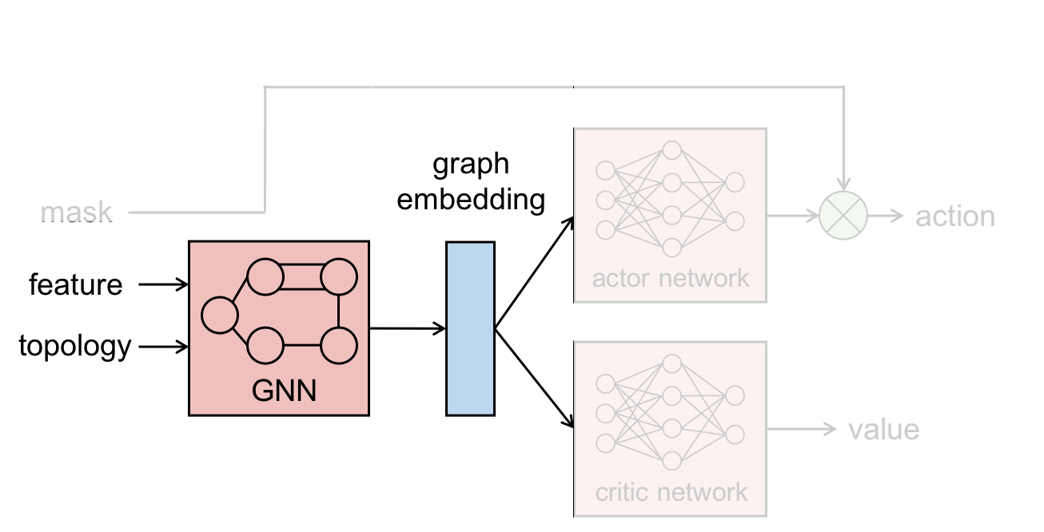
Challenge 3: How to encode network topology
Notes:
Then, challenge 3 is how to encode the network topology to generate the graph embedding

Slide 20
Challenge 3: How to encode network topology
Structural pattern
Link features
Parallel links
Notes:
There are three factors that make it challenging. Structural pattern, link features and parallel links

Slide 21
Challenge 3: How to encode network topology
Message propagation between neighbor nodes
Structural pattern
GNN
Link features
Parallel links
Notes:
First, the network topology is actually a graph. To capture its structural pattern, we leverage graph neural network(GNN) that performs message propagation between neighbor nodes.

Slide 22
Challenge 3: How to encode network topology
Structural pattern
GNN
Link features
Node-link transformation
Parallel links
Notes:
While GNNs are most mature for handling node features, here we care about link features, which
Is link capacity. What’s more, there may be multiple parallel links between two nodes.
To deal with these, we propose a domain-specific node-link transformation.

Slide 23
Challenge 3: How to encode network topology
B
C
BC1
AB
BC2
A
CE
AD
D
E
DE
Before transformation
After transformation
Notes:
This example shows the input topology before transformation on the left and the output topology after transformation on the right
The node names show the corresponding relationship between nodes and links.
Then the capacity becomes node feature in the transformed topology.
The two parallel links BC1 and BC2 are mapped to two nodes in the transformed topology.
We do not add links between nodes whose corresponding links in the input topology are parallel links,
For example, we do not add links between node BC1 and node BC2,
because the parallel links make contribution to the capacity between the same two nodes,
and we do not want to propagate the capacities of the parallel links during GNN training.

Slide 24

Implementation
Plan evaluator
LP problem
Optimization #1: source aggregation
Fewer constraints and variables
Optimization #2: stateful failure checking
https://github.com/netx-repo/neuroplan
Notes:
We implement the RL part based on the OpenAI SpinningUp framework and add support for GPU training
The plan evaluator checks if the current network plan satisfies the operational requirements,
by solving a linear programming (LP) problem with the Gurobi Optimizer.
There are two optimizations of the plan evaluator's implementation.
The first one is source aggregation, which aggregates the flows with the same source as one single flow.
It decreases the number of constraints and variables in the problem formulation
The second one is stateful failure checking.
Remember that only adding capacity is allowed in the action space.
if a network survives a failure, then a network with more capacity will survive the same failure.
So for each step, we check the failure scenarios starting at the failure that is not survived in the previous step instead of trying to solve all the failures at one time.
The code is publicly available at this github link.

Slide 25
Evaluation
Implementation efficiency
Optimality
Scalability
Sensitivity analysis
GNN layers
Relax factor
Hidden size of MLP
Maximum capacity unit
Notes:
The evaluation consists of the implementation efficiency. the optimality, scalability, sensitivity analysis

Slide 26
Evaluation
Implementation efficiency
Optimality
Scalability
Sensitivity analysis
GNN layers
Relax factor
Hidden size of MLP
Maximum capacity unit
Notes:
In this talk, we omit the last two items of the sensitivity analysis

Slide 27
Implementation efficiency
Notes:
we compare the running time of different implementations, including the vanilla plan evaluator (Vanilla), the plan evaluator with source aggregation (SA), and the plan evaluator with both source aggregation and stateful failure checking (NeuroPlan).

Slide 28
Implementation efficiency
Notes:
We measure the average running time for 10 epochs on the five topologies A,B,C,D,E, the scale from small to large.

Slide 29
Implementation efficiency
Notes:
The running time is normalized with the running time of NeuroPlan on each topology.

Slide 30
Implementation efficiency
Notes:
The crosses indicate that the running time is larger than 2 hours.

Slide 31
Implementation efficiency
Notes:
In the figure we can see SA reduces the running time by a factor of 2 with topology A.
The efficiency of SA is further for topologies with more flows in BCDE

Slide 32
Implementation efficiency
NeuroPlan is 7-14 times faster than SA.
Notes:
NeuroPlan is 7-14 times faster than SA because it applies the stateful failure checking.

Slide 33
Optimality
Notes:
We compare NeuroPlan and ILP on small-scale problems to evaluate the optimality of NeuroPlan.
We also report the results of Neuroplan's first-stage.

Slide 34
Optimality
Notes:
We vary the original capacities of the topology A to create multiple synthetic problems, (including 0%, 25%,50%,75%, and no change).
The problem is harder with a smaller original capacities.

Slide 35
Optimality
Notes:
The cost results are normalized with the results of ILP on each topology.

Slide 36
Optimality
NeuroPlan produces (near) optimal solutions
for small-scale problems.
Notes:
Comparing the red bars with the green bars, we see that NeuroPlan …

Slide 37
Scalability
Notes:
NeuroPlan can overcome the scalability issue encountered by ILP.
In this figure, we compare the results of First-stage, NeuroPlan, ILP-heur and ILP for five topologies.
ILP-heur integrates hand-designed heuristics into ILP to trade optimality for tractability.
For faithful comparison, we use the same heuristic setups used in the production network.

Slide 38
Scalability
Notes:
The cost results are normalized to that of ILP-heur on each topology.

Slide 39
Scalability
Notes:
The crosses indicate that ILP fails to scale to large topologies.

Slide 40
Scalability
NeuroPlan outperforms ILP-heur on large topologies and avoids human efforts to tune the heuristics.
Notes:
NeuroPlan outperforms ILP-heur on large topologies and avoids human efforts to tune the heuristics.

Slide 41
Sensitivity analysis
Impact of GNN layers
Notes:
For the sensitivity analysis, we first show the impact of different layers of GNN.
We show the cost results of first-stage, normalized with the optimal cost results.

Slide 42
Sensitivity analysis
Impact of GNN layers
GNN is essential for
large-scale problems.
Notes:
NeuroPlan can learn even without GNN for A-1, but failed on other complicated problems.
So we say GNN is essential for Neuroplan especially with large-scale problems.

Slide 43
Sensitivity analysis
Impact of GNN layers
Impact of relax factor
GNN is essential for
large-scale problems.
Notes:
On the right, we show the impact of relax factor alpha, which represents the size of the search space in the second stage.
The cost results are normalized with those of First-stage on each topology.

Slide 44
Sensitivity analysis
Impact of GNN layers
Impact of relax factor
GNN is essential for
large-scale problems.
A larger 𝜶 leads to
a better solution.
Notes:
Since RL already gets a solution close to optimal for topology A, second-stage does not improve a lot.
For other topologies, a larger α enables Neuorplan to get a better solution in a larger search space

Slide 45
Conclusion
NeuroPlan: a deep RL-based approach to solve the network planning problem
Use GNN and a domain-specific node-link transformation to encode topologies
Leverage a two-stage hybrid approach to find the final solution
Avoid human efforts to trade off between optimality and tractability
Notes:
To conclude, NeuroPlan is a deep RL-based approach to solve the network planning problem.
It uses graph nueral network and a domain-specific node-link transformation to encode network topologies,
and leverages a two-stage hybrid approach to find the final solution.
By doing so, it avoids human efforts to trade off between optimality and tractability in the current approach.

Slide 46
Thanks!
E-mail address: hzhu@jhu.edu
Notes:
That’s all and thanks for listening.

